Slide 1
Data visualization and github & reproducibility
Andrew Wilson, Phd, Mstat
Adjunct Asst Prof & Day job at Parexel

Slide 2


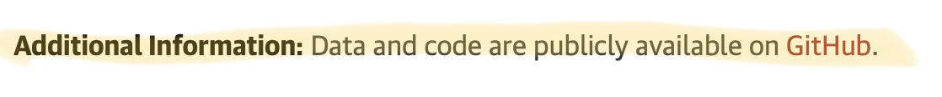
Agenda
How is everyone?
Introduction to some data visualization.
How to look under the hood of some publications: GITHUB.

Slide 3
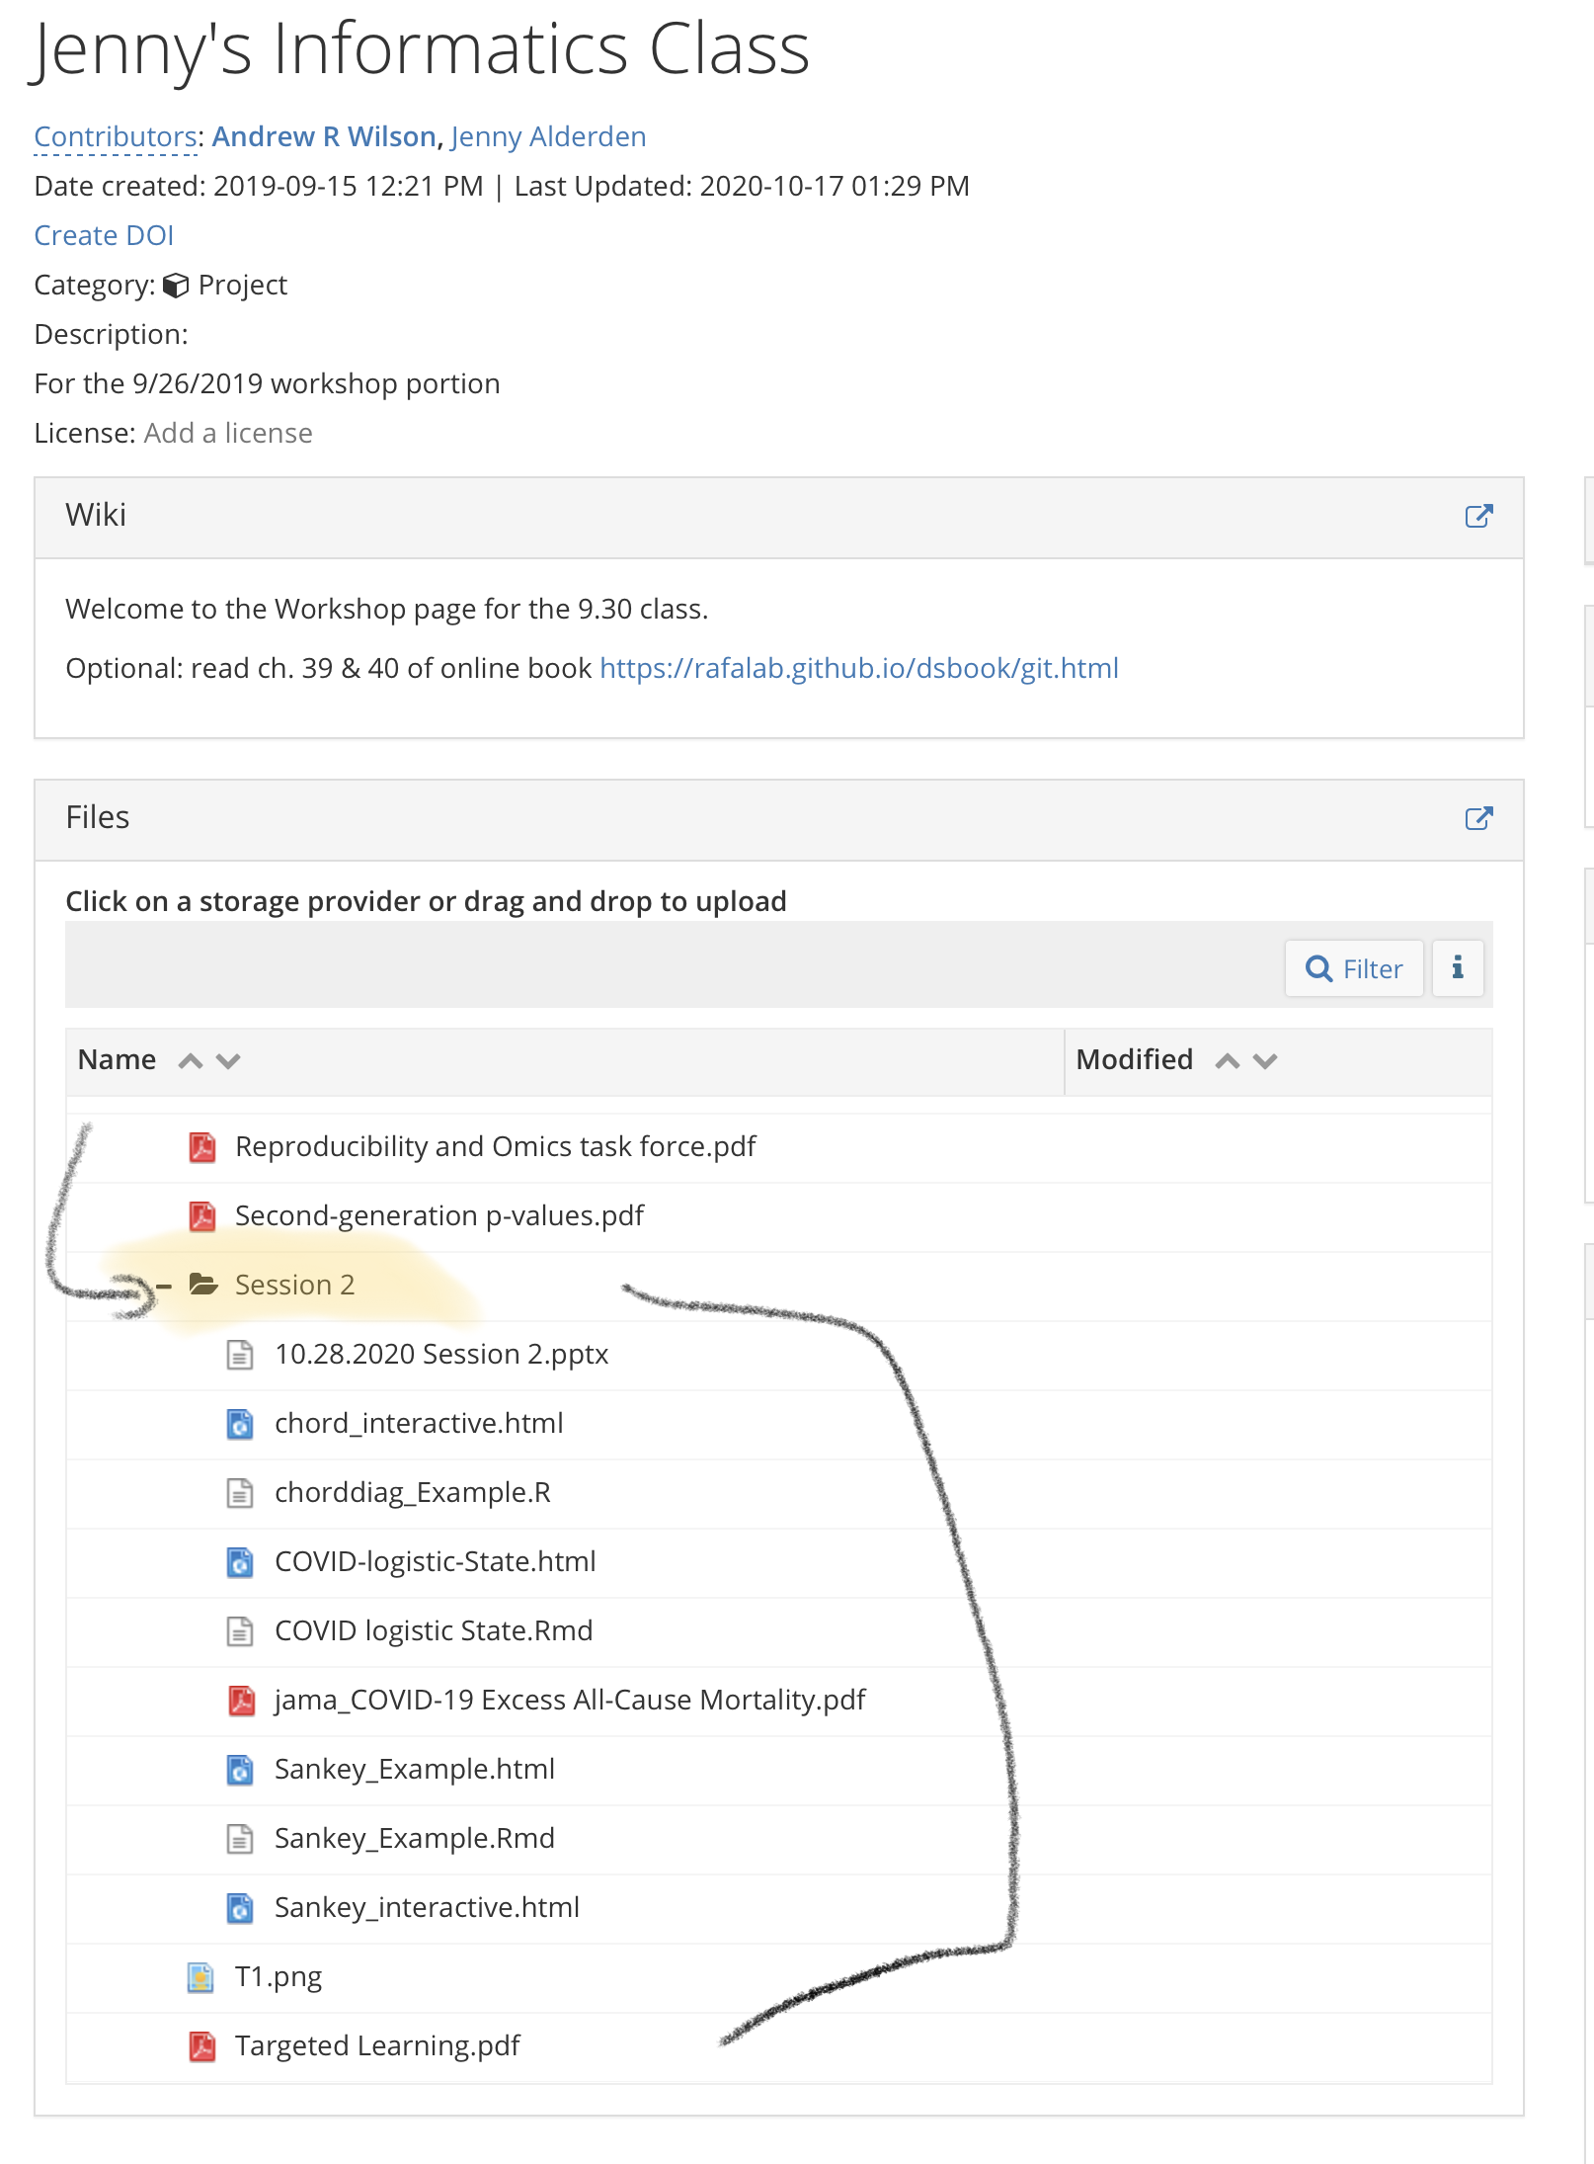
Everything’s updated on the OSF page

Slide 4
Data Viz

Slide 5
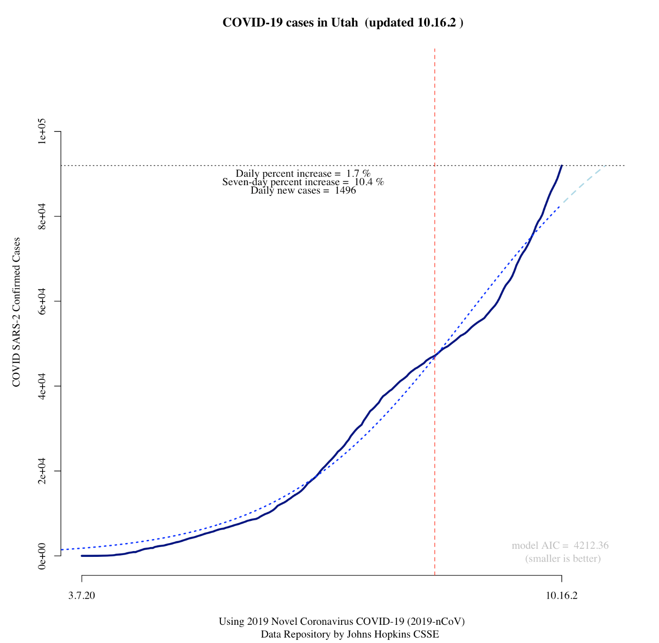
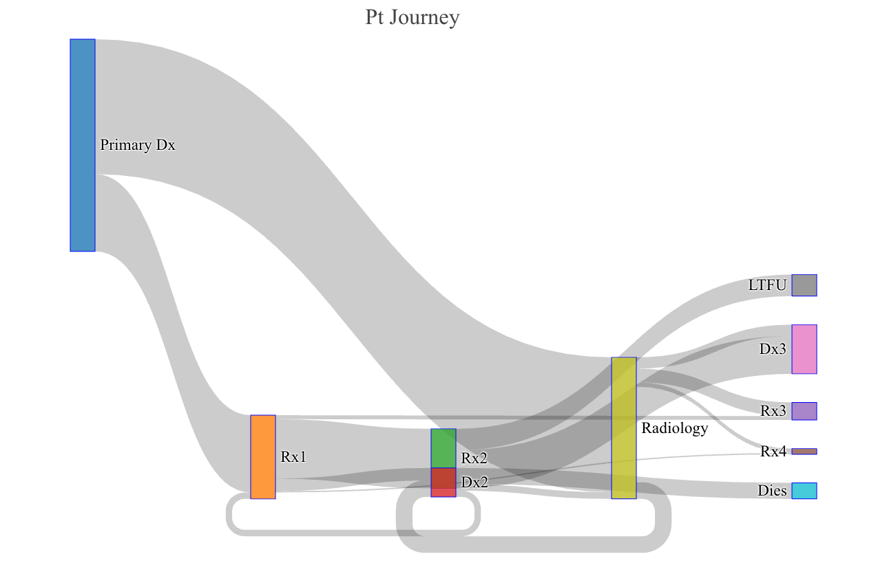
Two totally disparate examples
Time series (COVID by US state):
Sankey plots:
Patient journeys

Slide 6
Let’s go through the code
COVID logistic State.Rmd
Utah example
Produces:
COVID-logistic-State.html

Slide 7
Sankey_Example.Rmd
Produces:
Sankey_Example.html
Sankey_interactive.html

Slide 8
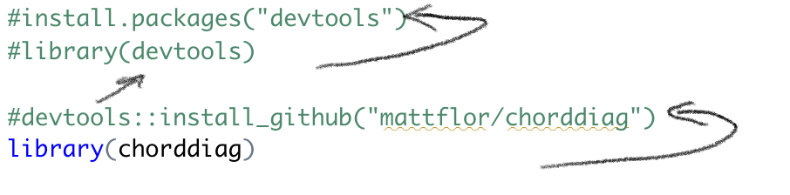
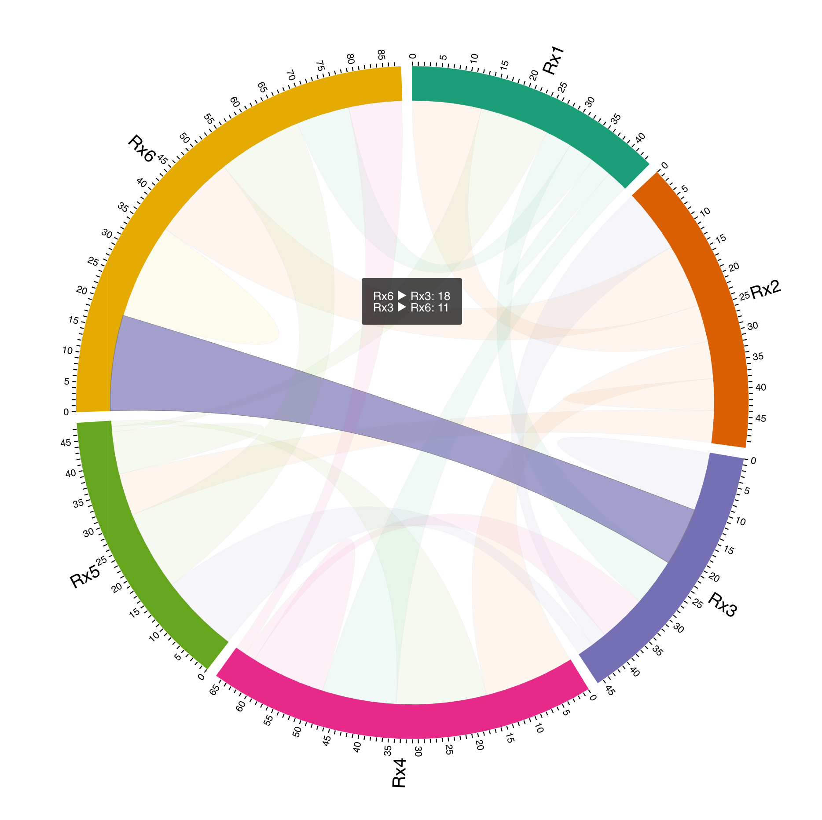
Working backward re: packages
chorddiag_Example.R
Produces:
chord_interactive.html

Slide 9
Github for JAMA paper

Slide 10
https://github.com/abilinski/MortalityCOVID19

Slide 11
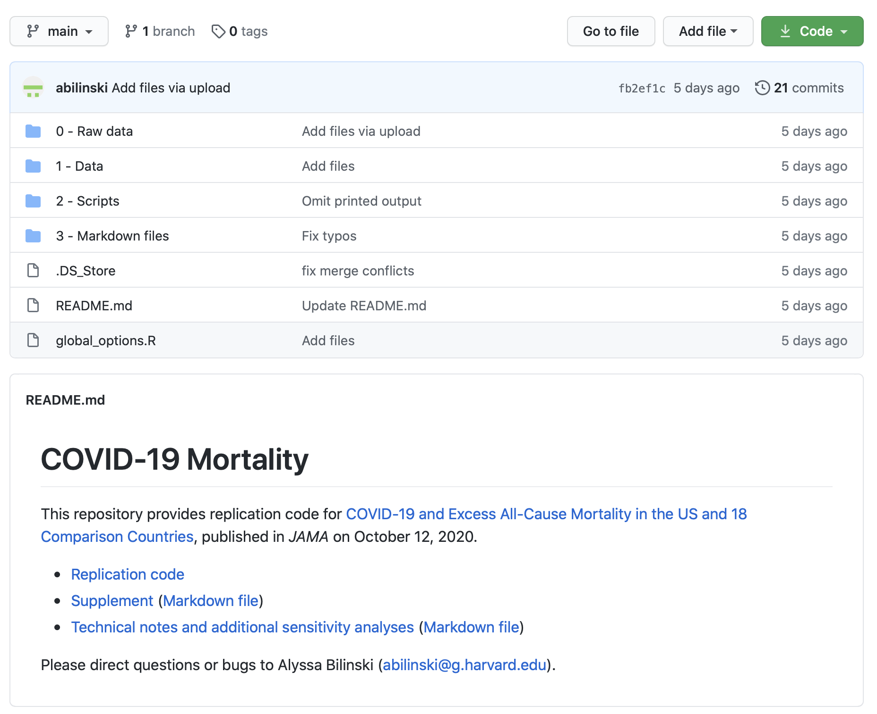

Slide 12

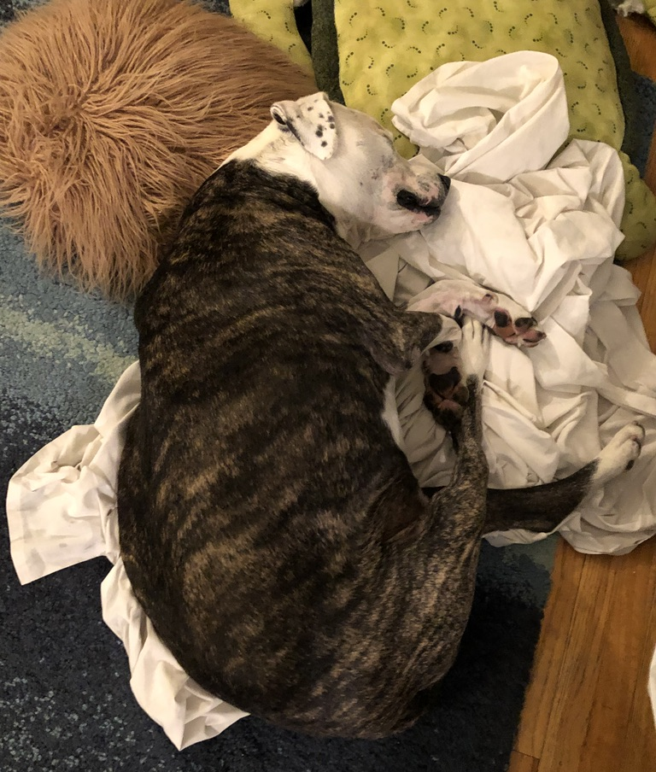
Thanks!

Slide 13

BONUS!
“Esquisse”
https://github.com/dreamRs/esquisse

Slide 14
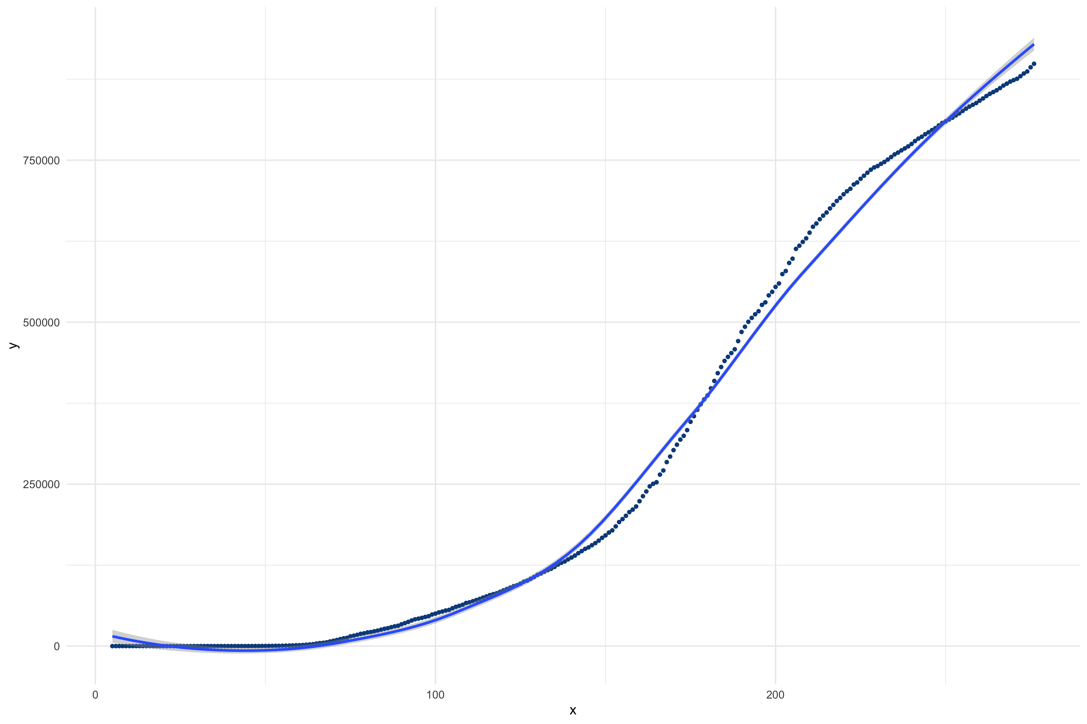
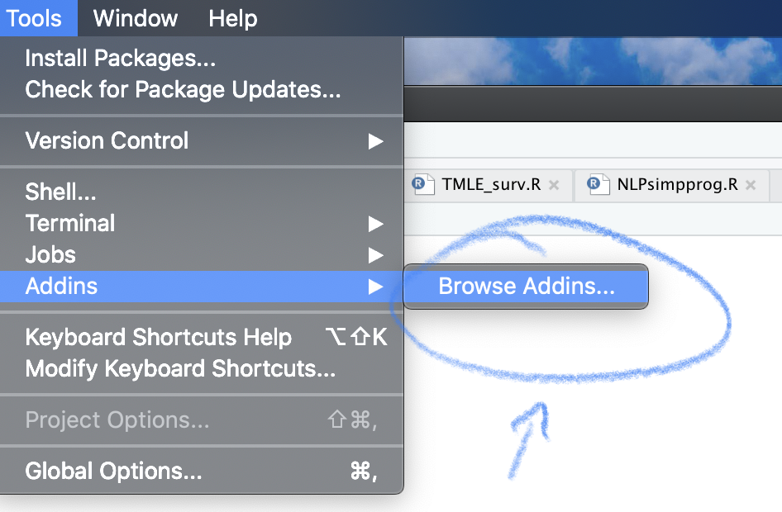
install.packages(‘esquisse’)

Slide 15
gganimate
Watch the Dakotas

